Slide 1

The Pattern of Information and Communication Sector
Fadhluddin Sahlan 1817445
Test 1 Big Data Analytics

Slide 2
Background
Information and communication sector is one of the most high demand sectors in Malaysia. Industry Revolution 4.0 encourage the demand where people nowadays can easily communicate in milliseconds even from far away distance. However, we still don’t know whether the hype toward this technology will be valid until when.

Slide 3
Data Science Question?
What is the industry involve in Information and Communication Section?
What is the pattern growth rate of each industry of above from 2015 to 2019?
What is the pattern of growth rate of Information and Communication section in Malaysia from 2015 to 2019?
What is the pattern of growth rate of each industry of above from 2015 to 2019 in Malaysia only?

Slide 4
Objectives
To analyse the validity of the sectors in the world
To identify the most needed industry of the sector in the world
To know which industry in the sector is the most requested in Malaysia
To analyse the pattern of growth of the sector in Malaysia

Slide 5

Methodology
Refer to the python code

Slide 6

Results

Slide 7

Industry involved in Information and Communication
'Computer Hardware’
'Computer Software’
'Computer Networking',
'Internet’
'Semiconductors’
'Telecommunications',
'Motion Pictures & Film’
'Broadcast Media’
'Newspapers',
'Publishing’
'Information Technology & Services',
'Writing & Editing’
'Computer Games’
'Online Media',
'Computer & Network Security’
'Wireless’
'Media Production'

Slide 8
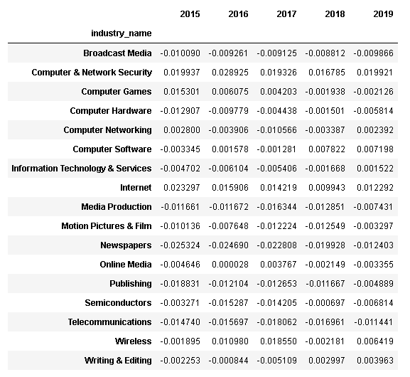
Growth rate of each industry from 2015 to 2019

Slide 9
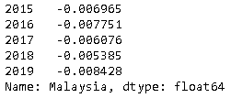
Growth rate of Information and Communication section in Malaysia from 2015 to 2019

Slide 10
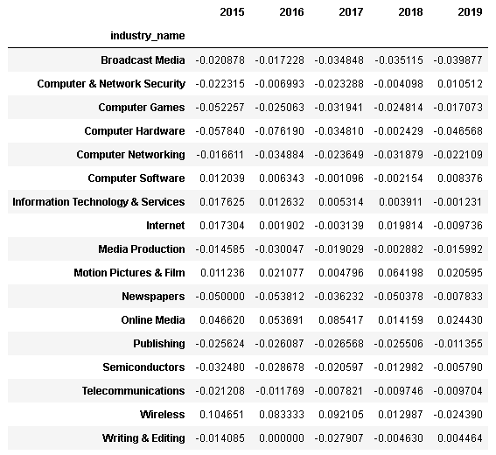
Growth rate of each industry from 2015 to 2019 in Malaysia

Slide 11

Visualizations

Slide 12
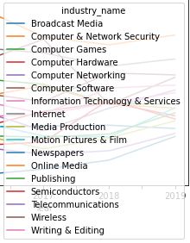
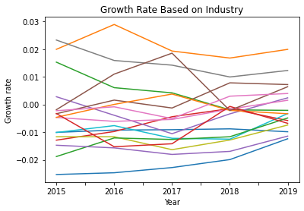
Growth rate of each industry from 2015 to 2019

Slide 13
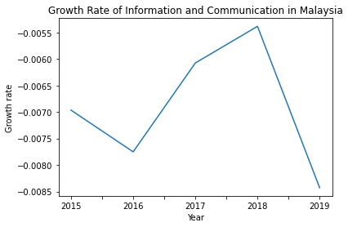
Growth rate of Information and Communication sector in Malaysia from 2015 to 2019
It appears t

Slide 14
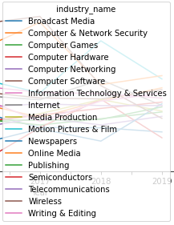
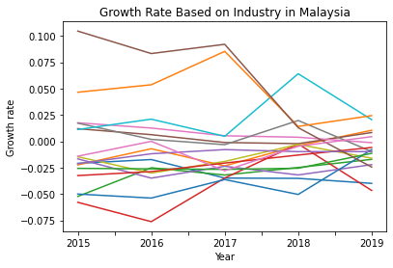
Growth rate of each industry from 2015 to 2019 in Malaysia

Slide 15
Discussion
From the analysis, we do know there are many industries involve in this sector as mentioned in previous slide in the result.
The current trend of past few years, the world show that most Information and Communication industries are increase in growth rate of employment. The industry that have the highest rate increase quickly are Computer & Network Security.
However, in Malaysia, Information and Communication sector overall shows decreasing trend in the growth rate of employment and even the worst recently in 2019 with the growth rate of -0.008428.

